Slide 1
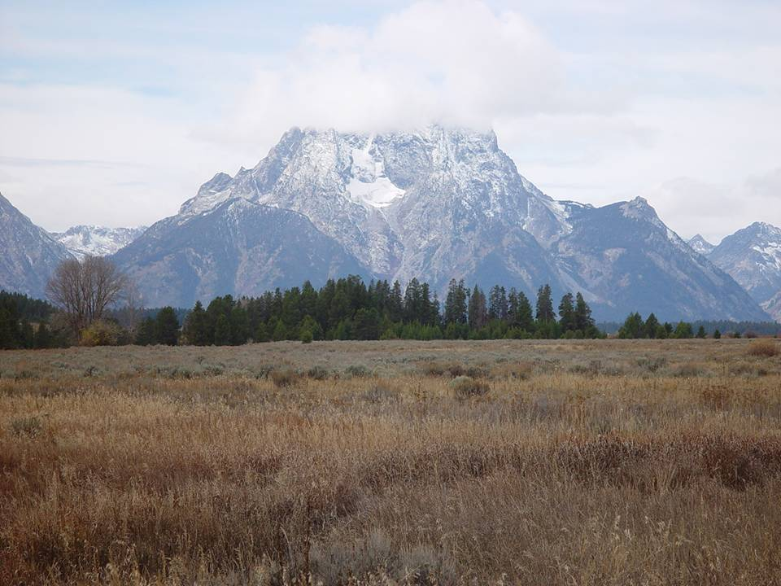
Federal Geographic Data Committee Vegetation Subcommittee
Briefing for FGDC Coordination Group
March 6, 2007
Ralph H. Crawford (Chair)
David Tart

Slide 2
FGDC National Vegetation Classification Standard
Purpose and Scope
Purpose
  Facilitate data-sharing between Federal agencies and partners.
  A cross-walking standard for vegetation data and information (local to global).
  Does not replace classification systems used by individual agencies.

Slide 3
FGDC National Vegetation Classification Standard
Purpose and Scope
Scope
  Mandatory that all vegetation data gathered using federal funds be collected in a manner that allows cross-walking to the NVC.
  Cross-walking requirement applies to:
    Vegetation plot data
    Vegetation types (taxonomic units)
    Vegetation map units

Slide 4
FGDC National Vegetation Classification Standard - 1997
History
Established a physiognomic/floristic vegetation hierarchy.
Established a content standard for the physiognomic levels.
  A list of vegetation types.
Initiated the development of a process standard for the floristic levels.
  How to define floristic vegetation types.

Slide 5











FGDC Vegetation Subcommittee
History
  U.S. Forest Service (lead agency) * Natural Resources Conservation Service * U.S. Geological Survey-BRD/NBII * U.S. National Park Service * U.S. Bureau of Land Management * U. S. Fish and Wildlife Service * National Aeronautics and Space Administration * Department of Defense * Environmental Protection Agency * NatureServe * Ecological Society of America (Vegetation Classification Panel)

Slide 6
History
Hierarchy Revisions Working Group
CANADA
Del Meidinger (British Columbia Ministry of Forests)
Serguei Ponomarenko (NatureServe-Canada)
  Jean-Pierre Saucier (Ministère des Ressources naturelles, Québec)
UNITED STATES
  Don Faber-Langendoen (NatureServe,) (co-chair)
  Dave Tart (U.S. Forest Service) (co-chair)
  Andy Gray (U.S. Forest Service)
  Bruce Hoagland (University of Oklahoma)
  Sherm Karl (Bureau of Land Management)
  Todd Keeler-Wolf (California Department of Fish and Game)
  Greg Nowacki (U.S. Forest Service)
  Alan Weakley (University of North Carolina - Botanical Garden)
LATIN AMERICA
  Otto Huber (Director of the COROLAB, Venezuela)
  Carmen Josse (NatureServe, Latin America)
  Alejandro Velasquez (Universidad Nacional Autónoma de México, Mexico)

Slide 7
NVC Milestones
History
1996-98.NVC Hierarchy completed by TNC (modified UNESCO 1973).
1997-98. FGDC adopts hierarchy as federal standard: Complete set of physiognomic units (content standard); Provisional set of floristic units.
1998. ESA Panel is tasked to create a set of guidelines and peer review process for floristic units.
1998-02. Partners test the hierarchy (USFS, NatureServe) and request revisions. Canadian partners begin collaboration on a Canadian NVC.
2003. Hierarchy Revisions Working Group to explore revisions to upper levels.
2004 ESA Panel completes its guidelines; FGDC begins work on standards for floristic units, based on dynamic content standard.
2005 HRWG completes its draft revisions, FGDC incorporates those revisions into standards process for all units. Mexican partners begin collaboration on Mexican NVC.

Slide 8
NVC Today
Current Status / Timeline
2006
FGDC Subcommittee revising the floristic and physiognomic parts of 1997 standard
Federal agencies working with provisional NVC in various ways (NPS-USGS, USFS FIA, LANDFIRE, NASA, GAP, etc).
NatureServe continues to maintain provisional set of associations and alliances.
ESA VegBank plot database now operational.
ESA Panel developing Peer Review Process.

Slide 9
Revision of the FGDC
Vegetation Classification Standard
Current Status / Timeline
Resolve identified problems with the physiognomic hierarchy.

Slide 10
Revision of the FGDC
Vegetation Classification Standard
Current Status / Timeline
Resolve identified problems with the physiognomic hierarchy.
Complete the process standard for classifying alliances and associations.

Slide 11
Revision of the FGDC
Vegetation Classification Standard
Current Status / Timeline
Resolve identified problems with the physiognomic hierarchy.
Complete the process standard for classifying alliances and associations.
Establish all levels of the FGDC hierarchy as a “dynamic content standard.”

Slide 12
Dynamic Content Standard
Current Status / Timeline
Initiates an innovative approach to streamline the FGDC standards process to revise the list of vegetation types.
The classification content would be maintained by an authorized body with oversight from a national peer review board.
Requires databases for vegetation types, plot data, and peer review tracking.
  Prototypes have been developed by NatureServe and the ESA Vegetation Panel.

Slide 13
Changes to the FGDC Hierarchy
Current Status / Timeline
Move Natural vs Cultural vegetation distinction to top of hierarchy.
Reduce and revise physiognomic levels.
Add new mid floristic levels that reflect broad phyto-geographic affinities.

Slide 14
Proposed FGDC Vegetation Hierarchy
(example)
Current Status / Timeline
Vegetated
Natural
Physiognomic
Class Forest and Woodland
Subclass Temperate Forest and Woodland
Formation Temperate Evergreen Broadleaf and Conifer Forest
Phyto-geographic-Floristic
Division Southeastern North American Evergreen Broadleaf and Conifer Forest
Macrogroup Southern Pine Forest
Group Shortleaf Pine - Loblolly Pine - Oak Forest
Floristic
Alliance Pinus taeda - Pinus echinata Alliance
Association Pinus taeda/Symplocos tinctoria-Morella cerifera-
Vaccinium elliotii Association

Slide 15
Hierarchy Revision
1997 Hierarchy |  | Proposed Hierarchy
Level | Criteria | Level | Criteria
Division | Vegetated vs. Non-vegetated | -------- | Vegetated vs. Non-vegetated
 |  | -------- | Natural vs. Cultural vegetation
Order | Dominant growth form | Class | Growth form ←→ Moisture-Temperature
Class | Canopy cover of growth forms
Subclass | Leaf morphology / herb periodicity
Group | Leaf morphology / Global climate | Subclass | Growth form ←→ Global climate
 |  | Formation | Growth form response to continental climate, topography, soils.
Subgroup | Natural vs. Cultural vegetation
Formation | Specific morphology of dominant growth forms / abiotic factors
 |  | Division | Biogeographic species groups similar in response to continental climate
 |  | Macrogroup | Biogeographic species groups similar in response to regional climate
 |  | Group | Biogeographic species groups similar in response to regional climate & soils
Alliance | Species in the dominant layer | Alliance | Species mostly in the dominant layer
Association | Species in all layers | Association | Species in all layers

Slide 16
Hierarchy Revision
1997 Hierarchy |  | Proposed Hierarchy
Level | Criteria | Level | Criteria
Division | Vegetated vs. Non-vegetated | -------- | Vegetated vs. Non-vegetated
 |  | -------- | Natural vs. Cultural vegetation
Order | Dominant growth form | Class | Growth form ←→ Moisture-Temperature
Class | Canopy cover of growth forms
Subclass | Leaf morphology / herb periodicity
Group | Leaf morphology / Global climate | Subclass | Growth form ←→ Global climate
 |  | Formation | Growth form response to continental climate, topography, soils.
Subgroup | Natural vs. Cultural vegetation
Formation | Specific morphology of dominant growth forms / abiotic factors
 |  | Division | Biogeographic species groups similar in response to continental climate
 |  | Macrogroup | Biogeographic species groups similar in response to regional climate
 |  | Group | Biogeographic species groups similar in response to regional climate & soils
Alliance | Species in the dominant layer | Alliance | Species mostly in the dominant layer
Association | Species in all layers | Association | Species in all layers

Slide 17
Hierarchy Revision
1997 Hierarchy |  | Proposed Hierarchy
Level | Criteria | Level | Criteria
Division | Vegetated vs. Non-vegetated | -------- | Vegetated vs. Non-vegetated
 |  | -------- | Natural vs. Cultural vegetation
Order | Dominant growth form | Class | Growth form ←→ Moisture-Temperature
Class | Canopy cover of growth forms
Subclass | Leaf morphology / herb periodicity
Group | Leaf morphology / Global climate | Subclass | Growth form ←→ Global climate
 |  | Formation | Growth form response to continental climate, topography, soils.
Subgroup | Natural vs. Cultural vegetation
Formation | Specific morphology of dominant growth forms / abiotic factors
 |  | Division | Biogeographic species groups similar in response to continental climate
 |  | Macrogroup | Biogeographic species groups similar in response to regional climate
 |  | Group | Biogeographic species groups similar in response to regional climate & soils
Alliance | Species in the dominant layer | Alliance | Species mostly in the dominant layer
Association | Species in all layers | Association | Species in all layers

Slide 18
Hierarchy Revision
1997 Hierarchy |  | Proposed Hierarchy
Level | Criteria | Level | Criteria
Division | Vegetated vs. Non-vegetated | -------- | Vegetated vs. Non-vegetated
 |  | -------- | Natural vs. Cultural vegetation
Order | Dominant growth form | Class | Growth form ←→ Moisture-Temperature
Class | Canopy cover of growth forms
Subclass | Leaf morphology / herb periodicity
Group | Leaf morphology / Global climate | Subclass | Growth form ←→ Global climate
 |  | Formation | Growth form response to continental climate, topography, soils.
Subgroup | Natural vs. Cultural vegetation
Formation | Specific morphology of dominant growth forms / abiotic factors
 |  | Division | Biogeographic species groups similar in response to continental climate
 |  | Macrogroup | Biogeographic species groups similar in response to regional climate
 |  | Group | Biogeographic species groups similar in response to regional climate & soils
Alliance | Species in the dominant layer | Alliance | Species mostly in the dominant layer
Association | Species in all layers | Association | Species in all layers

Slide 19
Implementation Needs
Support Needs
Databases (e.g., VegBank, Biotics4, Peer Review Tools) have been built in support of NVCS, but need further development; tools have been prototyped, but need further development.
A large backlog of vegetation types will need to be peer reviewed to begin implementation of the FGDC Standard.
Peer review and data management for the dynamic content standard will require stable ongoing funding (move away from an ad-hoc funded collaboration).

Slide 20
Questions

